Slide 1
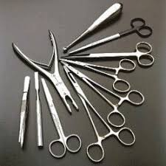
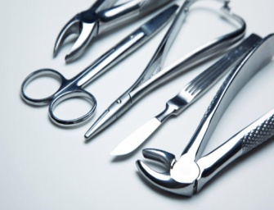
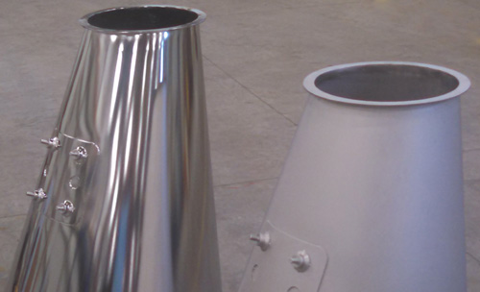
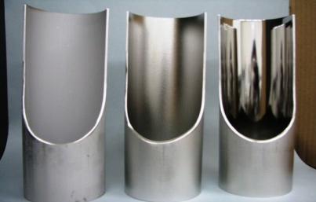
Workshop on
Fundamental Aspects & Recent Developments in Electropolishing
27th March, 2019 Lahore, Pakistan
Pakistan Institute of Technology for Minerals and Advanced Engineering Materials (PITMAEM) is deeply involved in research and development and fully equipped with high-tech equipment to provide testing/analytical facilities mainly for Automotive, Textile, Steel, Chemical, Petrochemical, Composite, Surgical and Rubber Industry.
Keeping in view the present scenario PCSIR has mandated PITMAEM to organize practical workshop on electropolishing. Electropolishing, also known as electrochemical polishing, anodic polishing or electrolytic polishing, is an electrochemical process that removes material from a metallic workpiece. It is used to polish, passivate and deburr metallic parts. It is often described as the reverse of electroplating. The workshop is focused to provide Academia and other professionals, a forum to actively engage in the surface enhancement of tools and create opportunities to enhance their professional skills. In addition to a comprehensive technical programme, participants will be benefitted from a practical demonstration of the whole process.
Objectives:
This workshop aims mainly to provide opportunities for Academia to:
Improve the electropolishing process.
Meet International standards for surface fineness.
Perform the complete process in the controlled parameters.
Optimization of Parameters.
Export Enhancement.
Value Addition.
Safety Features.
Who Should Attend:
Faculty Members
PhD / M.Sc Students
B.Sc Engineering Final Year Students
Workshop Fee/ Registration (Rs. 1,000/- per participant)
Tel: +92 42 99231798
PABX No. +92 42 99230688–95
Fax: +92 42 99231795
Cell: +92 313 4232628
E-mail: pitmaem.lhr@gmail.com
Organized By
Pakistan Institute of Technology for Minerals and Advanced Engineering Materials (PITMAEM)
Pakistan Council of Scientific & Industrial Research Laboratories Complex Lahore.
Ministry of Science & Technology (MoST), Government of Pakistan
Last Date to Register: 18th March 2019

